Slide 1
Infinite Dungeon Survival
Hunter Blake, Elliotte Wideman, Chancelor Brown

Slide 2

1. Project Info
The current title of the game is Infinite Dungeon Survival.
The team members are Elliote Wideman, Hunter Blake, and Chancelor Brown.
The current platform for our game would be PC/Home computers, and web browsers.
We currently don’t have any plans to monetize this game at all.

Slide 3
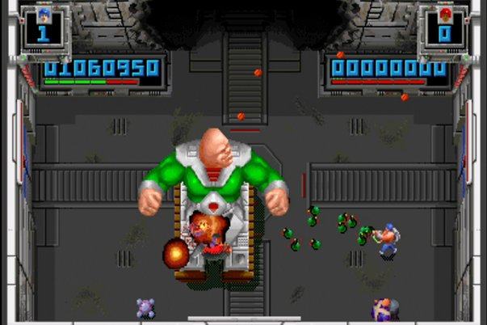
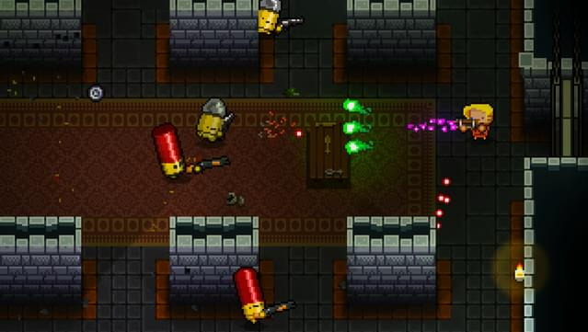
2. Game Overview & Vision
The High Concept of the game is that it’s a top-down twin stick rougelike shooter game with infinite waves of enemies similar to Enter the Gungeon and Smash TV.
The game, as mentioned before, will focus on the player against a progressively difficult series of waves of enemies, hazards, and obstacles with the only goal being to survive as long as possible. The only hook is that it would be a fun, arcade like experience of a game.
After the game starts, the player will be met with multiple waves of futuristic enemies that will attack the player. Every so often, they will likely be able to purchase an item or two from the game’s shop. After ten minutes, the player likely would’ve been finished with at least 3 or 4 waves.
The selling point is that it is an ambitious class project made by a group of people that enjoy video games and have demonstrated their interest and knowledge in game development by making this one.
The current audience would be our teacher, classmates, and anyone in the future that may see this game as a part of our portfolios.
The genre is an independent bullet hell or rougelike. This game takes inspiration from Smash TV and Enter the Gungeon.
The tone is a bleak futuristic setting in a game arena. Excitement, tension, desperation, and resignation are the core feelings of the setting. It is planned to have a pixel art style for the game.

Slide 4
3. Core Gameplay Design
The Core Gameplay Loop is the player attacks the enemies and avoids their attacks and obstacles. When all enemies are defeated, the next waves follows up with a more difficult, randomized set of enemies and traps. Aside from progressing to the next wave, the player could occasionally be able to purchase items from the shop.
The only player progression there comes from the items they could purchase. The only other thing that grows over time is the challenge of each wave.
The idea is for the player to use a controller with the left control stick being used to move the character and the right control stick to aim and shoot hence the genre, twin stick shooter. An alternative playstyle would be the keyboard and mouse for the respective controls.
The baseline difficulty of the game is based off of the waves. From the 1st wave, it would start off as not too bad and would progressively change to challenging, incredibly difficult, and eventually if the player is skilled enough, impossible to complete.
The player would receive a notification for when each wave starts or when they’re about to enter a shop. A sound would also play whenever the character is hit and eventually, a theme would play upon the character’s death.

Slide 5

4. Game Mechanics & Systems
Top-down 2D twin-stick shooter in dystopian arena combat
Survive enemy waves as they enter the arena from North, South, East, and West walls
Gun & limited AoE attack against drones, robots, and bio-creatures
Earn credits per kill to purchase upgrades from mysterious vendor
Choose between weapon damage, AoE damage, or max health upgrades
Combat emphasizes crowd control and spatial awareness while managing enemies from all directions, dodging projectiles, avoiding laser traps, and making strategic positioning and resource decisions
Notes:
Infinite Dungeon Survival is a top-down 2D shooter where players control a contestant in “The Trials” – an arena competition that pits the down-trodden against waves of futuristic enemy combatants. The gameplay centers on surviving waves of drones, robots, and bio-engineered creatures that spawn from all four directions.
Players use twin-stick controls with two main attacks: a standard gun and a limited-use --- area-of-effect --- ability. Each defeated enemy drops credits, with harder enemies giving more credits.
Between waves, a vendor appears offering three upgrade options: weapon damage, AoE damage, or maximum health. Players spend their credits based on what they need most for their playstyle.
The combat focuses on crowd control and spatial awareness, where the player is managing dozens of enemies coming from all sides while dodging projectiles and avoiding laser traps positioned throughout the arena. Success comes down to strategic positioning and resource management.

Slide 6

5. Narrative, World, & Characters
Year 2099: corporate dystopia with scarce resources hoarded by elites
Players are contestants in "The Trials" - brutal combat entertainment
Fighting for promised freedom and citizenship they'll likely never receive
Arena serves as both mass distraction and propaganda tool
Mysterious vendor: potentially rebellious AI or sympathetic insider
Notes:
The game is set in 2099, where society has collapsed under corporate control. Resources are scarce and controlled by the elite, leaving those at the bottom rung of society to fight for survival.
The player is a contestant who volunteered for The Trials, seeking freedom and citizenship. The Trials serve two functions: they're entertainment for the masses and propaganda that reinforces the ruling party's power.
The core theme is survival against overwhelming odds. There's no win condition - instead, players are measured by how long they last and how many waves they complete.
Between waves, a mysterious vendor offers upgrades. Their identity is unknown - possibly a rogue AI or someone within the system who's sympathetic to the plight of the contestants.
The player's only meaningful choice is how to spend credits between waves. This economic decision represents their one area of control in an otherwise predetermined system.

Slide 7
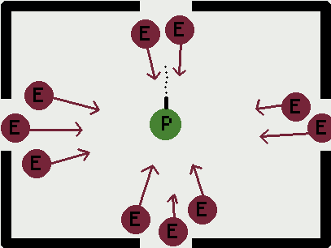
6. Level & Encounter Design
Single sealed arena with enemies from all four directions
Wave-based survival
Success measured by survival duration and waves completed
Laser traps restrict navigable space
Decaying futuristic aesthetics reflect societal collapse
Notes:
The entire game takes place in a single sealed arena. Enemies spawn from all four directions - north, south, east, and west - which creates a confined space focused on crowd control and positioning.
The objective is straightforward: survive each timed wave by eliminating all enemies. Success is measured by survival time and total waves completed.
The gameplay loop is consistent. Players use twin-stick controls to move and shoot while avoiding enemies and projectiles.
After clearing a wave, the mysterious vendor appears for upgrades. Then the next wave begins with increased difficulty.
The arena itself adds hazards through laser traps that limit movement space. If players survive the wave timer, they progress to the next round.
The visual design reinforces the setting – a crumbling infrastructure adorned by flickering neon lights and rusted metal panels that reflects the world's collapse. Cameras are mounted throughout the arena, emphasizing that players are both competitors and entertainment for an audience.

Slide 8
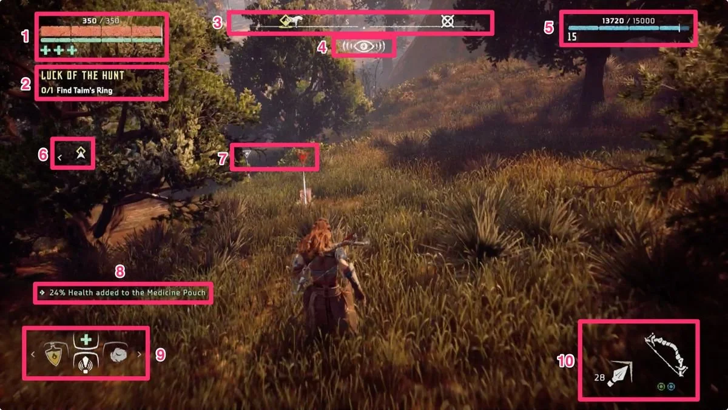

7. UI, UX, & Accessibility
Core Ui Elements:
Health/Shield bar (top-left)
Gold counter & wave timer (top-right)
Ammo & cooldown indicator (bottom-center)
Menus & Screens:
Main menu: Start, Settings, Quit
Pause Menu: Resume, Settings, Return to Main
Upgrade Vender: Upgrade options & cost
GameOver: Displays waves survived, kills, gold
https://www.iabdi.com/designblog/2022/6/1/nier-automata-chips

Slide 9
8.Production Team & Milestones
Team Roles
Elliotte Wideman
Project lead/Programmer/ Docs
Hunter Blake
Narrative Design/ Writing/Ui Ux/programmer
Chancelor Brown
Design Consultant/ Mechanics Testing/ Programmer
Development Milestones:
Pre-Production
(Sep 20 – Oct 5): Brainstorm + GDD
Sprint 1
(Oct 19 – 28): Movement, Shooting, HUG
Sprint 2
(Nov 9 –18): Wave logic, Vendor, Tutorial
Final Build
(Nov 23): Polish + presentation

Slide 10
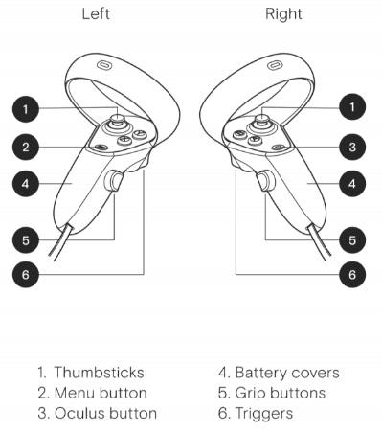
Risks & Out-of-Scope
Risks & Constraints:
Tight timeline and limited team size
Balancing difficulty curve
Hardware or testing issues
Out-of-Scope:
Multiplayer functionality
Procedural map generation
Branching storylines
Add VR/AR compatibility
Reference: image thumbsticks:
https://www.gamearter.com/blog/xr-input-manager-controllers

Slide 11
9. Schedules
Summary:
Pre-Production (Sep 20 – Oct 5): Concept + Setup
Sprint 1 (Oct 19 – 28): Core Mechanics
Sprint 2 (Nov 9 – 18): Systems + UI Integration
Deliverables (Nov 14 – 17): Poster Draft / C-Day Submission
Final Build (Nov 23): Polish and Release

Slide 12
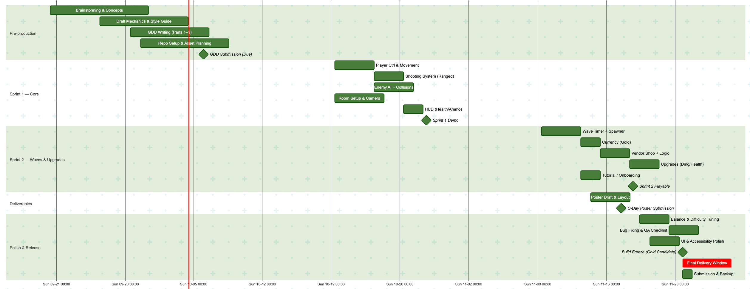
Gnatt Chart

